Slide 1
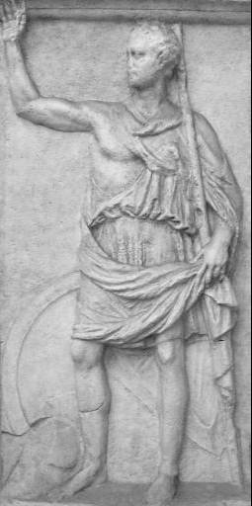
Polybius
c. 200-118 BCE
Born in Megalopolis in Arcadia, Greece
Prominent local politician and military leader
Lived in Rome as a hostage c. 167-150 BCE
Wrote Histories (in Greek) covering 264 to 146 BCE

Slide 2
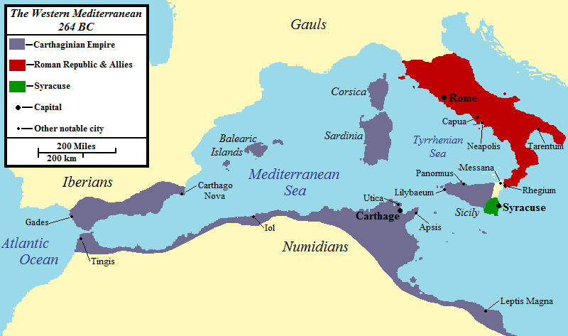
The Carthaginians…

Slide 3
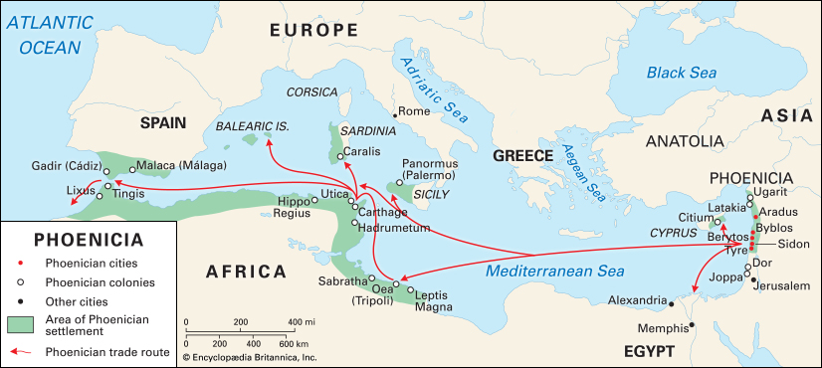
The Phoenicians

Slide 4
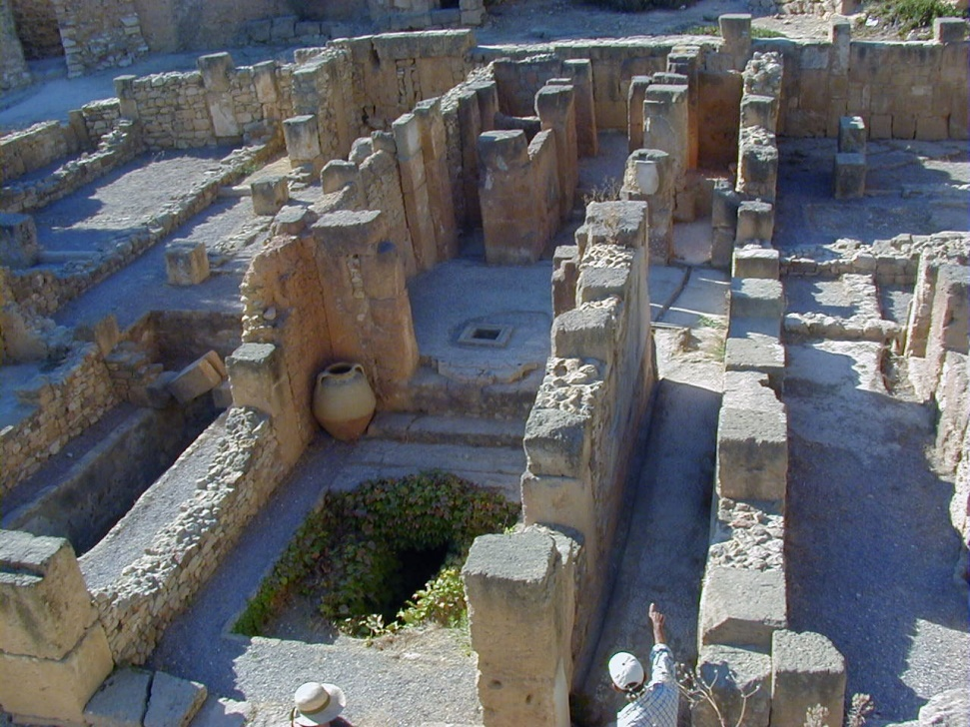
Carthage
Supposedly founded in 814 BCE by Phoenicians as Qaart-Hadasht (‘New Town’)
Spoke Phoenician, a Semitic language called ‘Punic’ by the Romans
Maritime commercial power with an extensive agricultural hinterland
Created an empire of trading colonies in the western Mediterranean

Slide 5
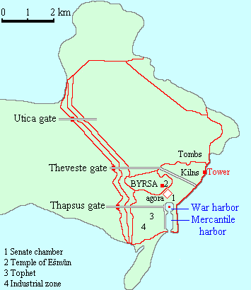
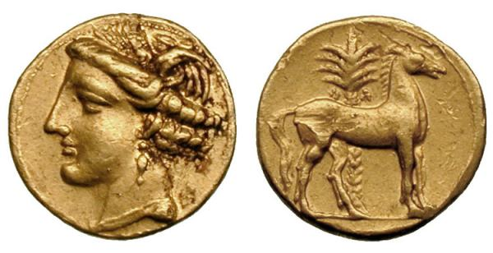
Carthage
Gold coin of Carthage, c.270-264 BCE, featuring the head of Tanit and a horse standing in front of a palm tree

Slide 6
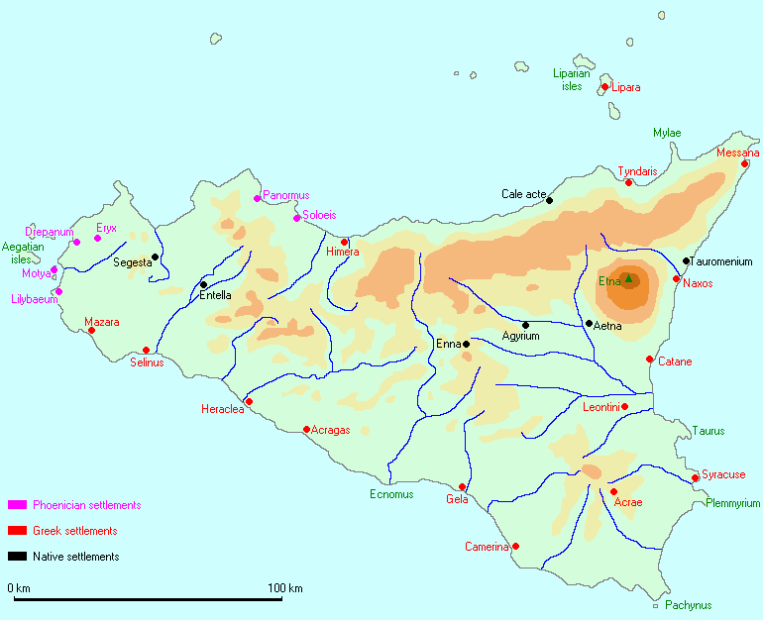
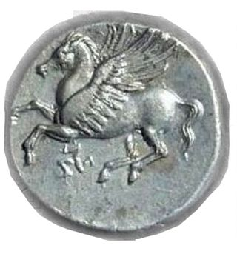
Sicily
Agathocles ,tyrant and king of Syracuse (r. 316-289 BCE)

Slide 7
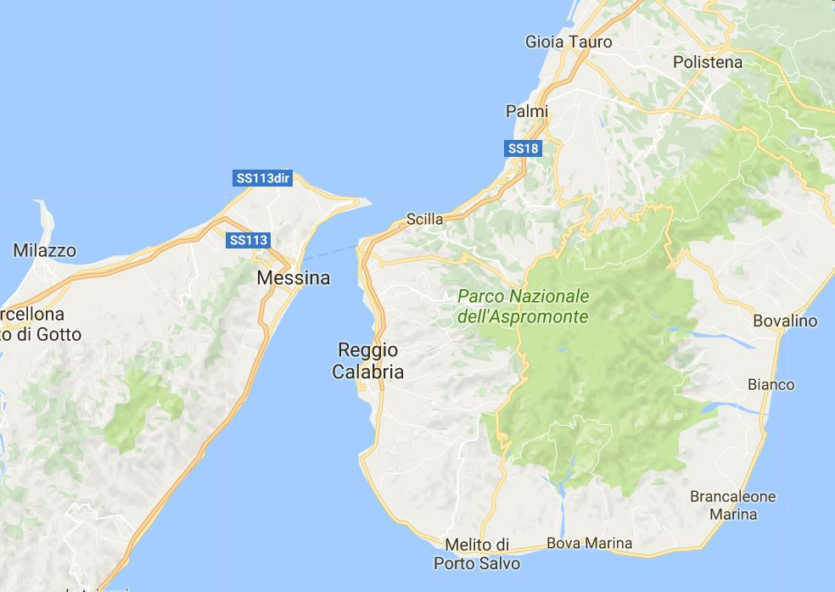
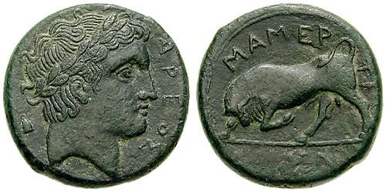
Mamertines
Italian mercenaries hired by Agathocles
Named for Mamers, Oscan name for Mars
Leaderless after the death of Agathocles in 289 BCE, they seized Messana and Rhegium
Besieged by Syracuse, they asked both Carthage and Rome for help
*
Bronze Mamertine coin from Messana, with the head of Adranus and a charging bull, c. 288-278 BCE

Slide 8
First Punic War (264-241 bce)
Messana (263; Hieron defeated)
Syracuse (263)
Acragas (262)
Lipara (261)
Cape Mylae (260)
Ecnomus (256)
Regulus’ raid (256-5)

Slide 9

Hamilcar Barca
c. 285-229/8 BCE
General in command of Carthaginian forces in western Sicily during the years 247-241 BCE
Harried the Roman forces besieging Lilybaeum and Drepanum from his base on Mt. Eryx
Hence the name Barca = ‘the thunderer’
Hamilcar ‘Hulk’ Barca

Slide 10
First Punic War (264-241 bce)
Panormus (254)
Lilybaeum and Drepanum (247-241)
Aegates Islands (241)

Slide 11
Peace
*
“There will be friendship between the Carthaginians and Romans on the following terms if approved by the Roman people: the Carthaginians to evacuate the whole of Sicily and not to make war on Hieron or bear arms against the Syracusans or the allies of the Syracusans; the Carthaginians to give up to the Romans all prisoners without ransom; the Carthaginians to pay to the Romans by installments in twenty years two thousand two hundred Euboean talents.”
- Polybius 1.62.8-9

Slide 12
Carthaginian Expansion in Spain
Hamilcar goes to Spain
Carthago Nova founded in 227
Romans make a treaty with Hasdrubal banning him from crossing the Ebro River in 226/5
Rome allied with Saguntum, which Hannibal captured in 219

Slide 13
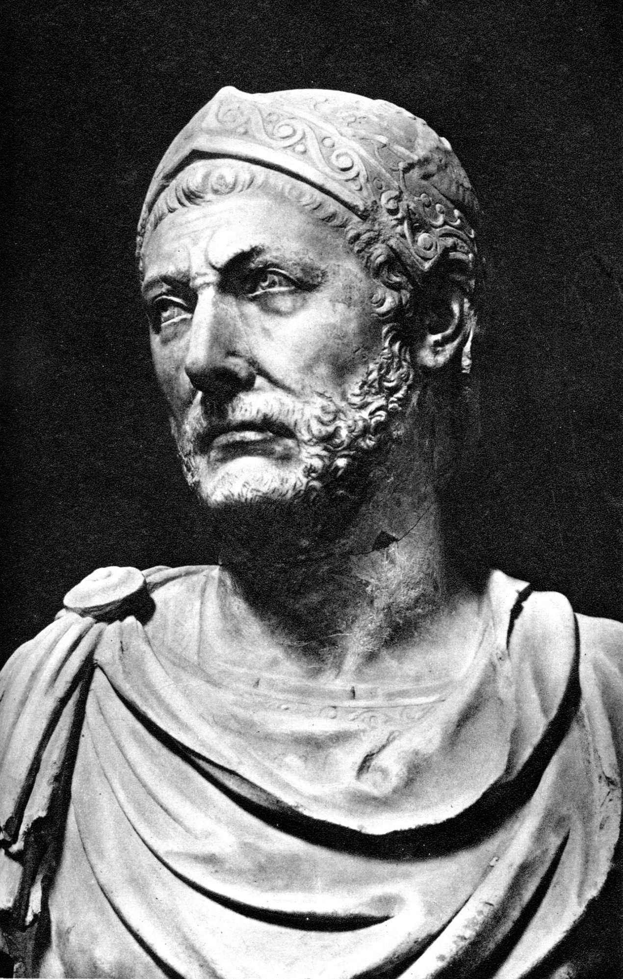
Hannibal
c. 247-183 BCE
Son of Hamilcar Barca, and brother-in-law of Hasdrubal
Succeeded Hasdrubal as Carthaginian commander in Spain in 221
Widely regarded as one of the best generals in antiquity
Hannibal?

Slide 14
Second Punic War (218-201 bce)
Hannibal
Cornelius Scipio, Sr.
Tiberius Sempronius

Slide 15
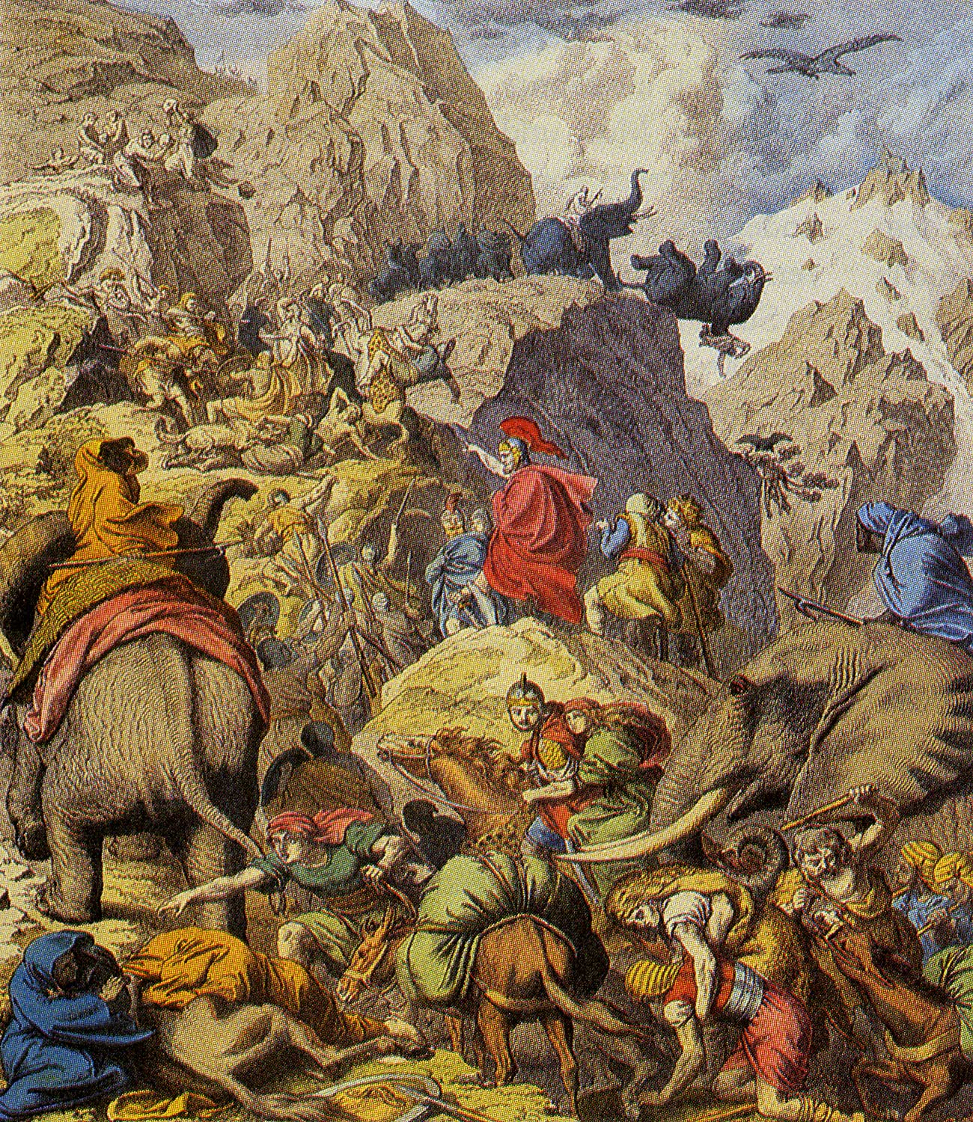
Hannibal Crosses the Alps
Left Spain in the summer of 218 BCE with 59,000 men and 38 elephants
Crossed the Alps in the fall, losing three-fifths of his army along the way
Reached Italy in December and bolstered his army with rebellious Gauls from the Po River Valley

Slide 16
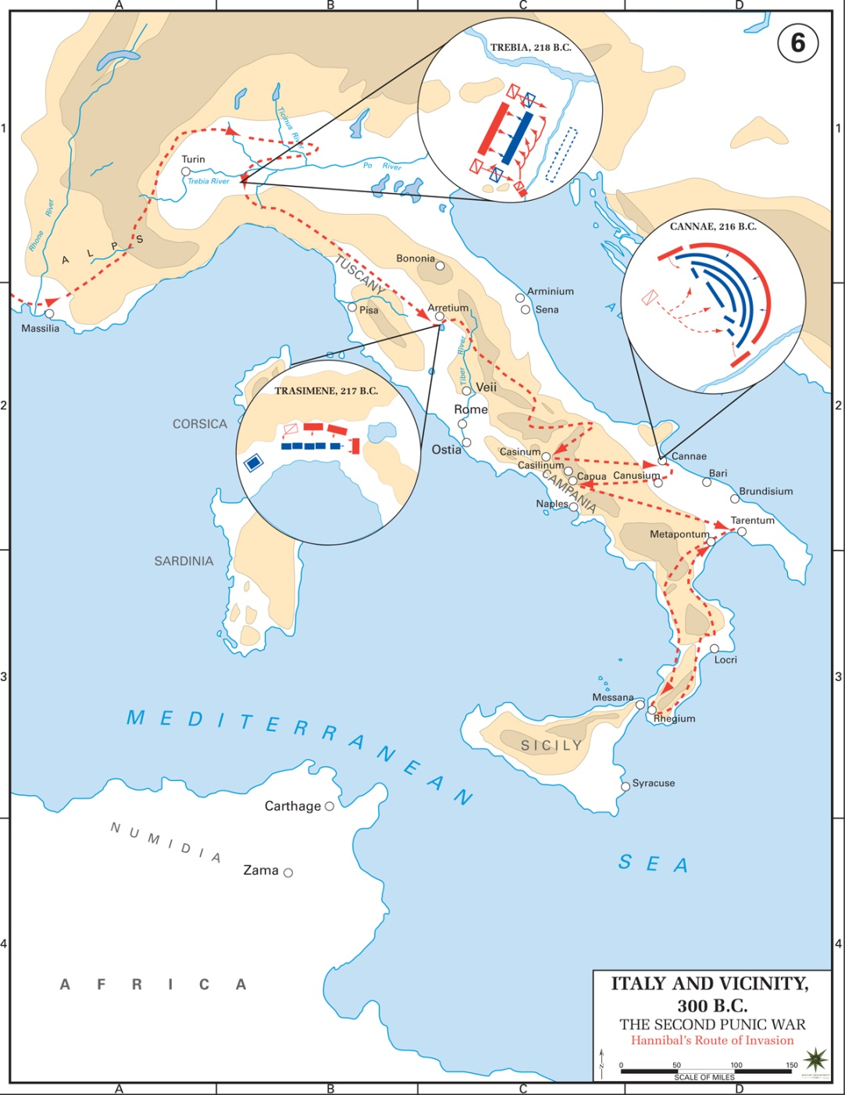
Hannibal in Italy
Trebia (218)
Lake Trasimene (217)
Cannae (216)

Slide 17
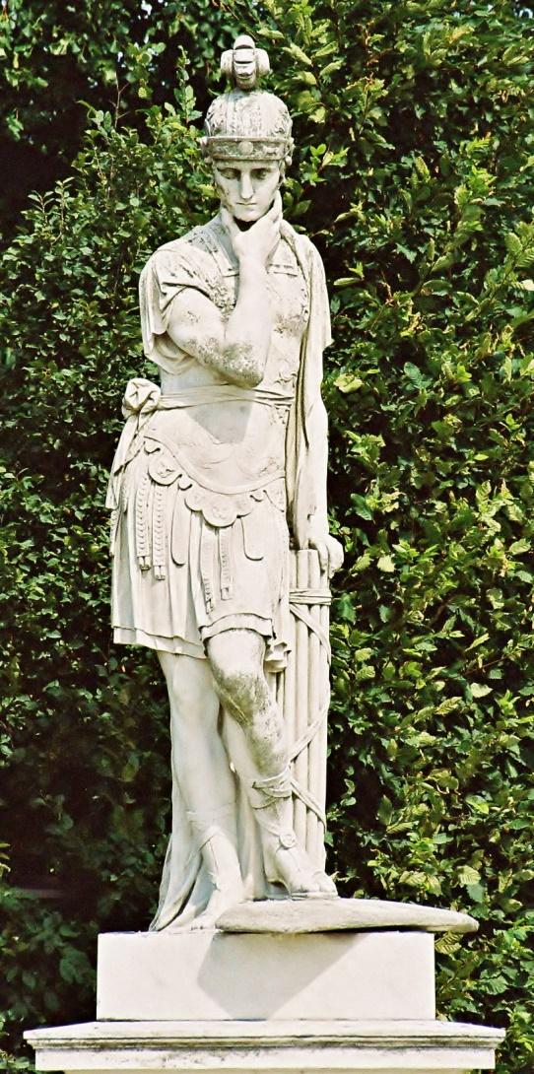
Fabius Cunctator
Quintus Fabius Maximus Verrucosus Cunctator
Verrucosus = ‘warty’
Cunctator = ‘the delayer’
c. 280-203 BCE
Consul in 233, 228, 215, 214, and 209
Dictator in 221 and 217
“By delaying one man restored our state” (Ennius)

Slide 18
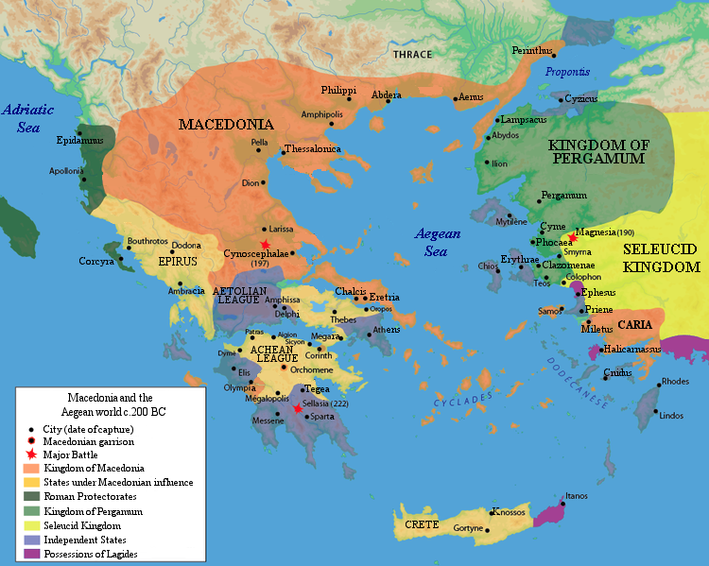
The Greek Theater
Hannibal forms alliances with Philip V of Macedon and Hieronymus of Syracuse
Romans respond by forming alliances with the Aetolian League, Attalus I of Pergamum, Sparta, Illyria and Thrace

Slide 19
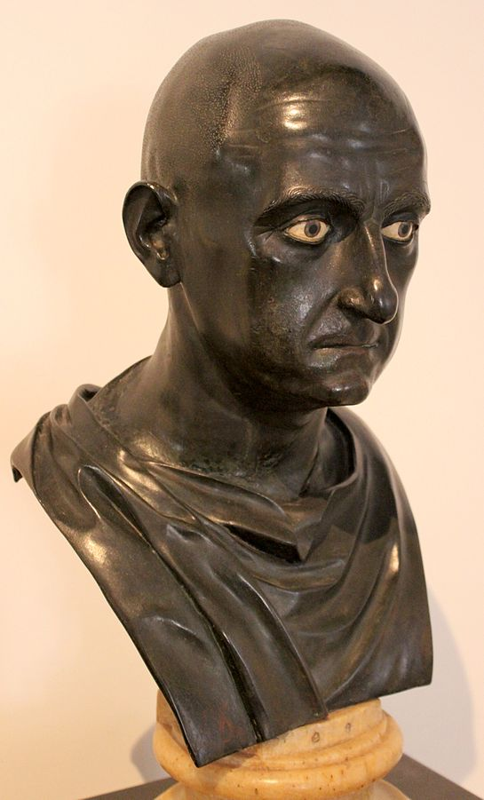
Scipio Africanus
Publius Cornelius Scipio Africanus
c. 236/5-183/4 BCE
Son of Publius Cornelius Scipio (senior)
Elected proconsul to replace his father and uncle in Spain in 210
Captured Carthago Nova and drove the Carthaginians from Spain
Elected consul in 205; crossed to north Africa in 204

Slide 20
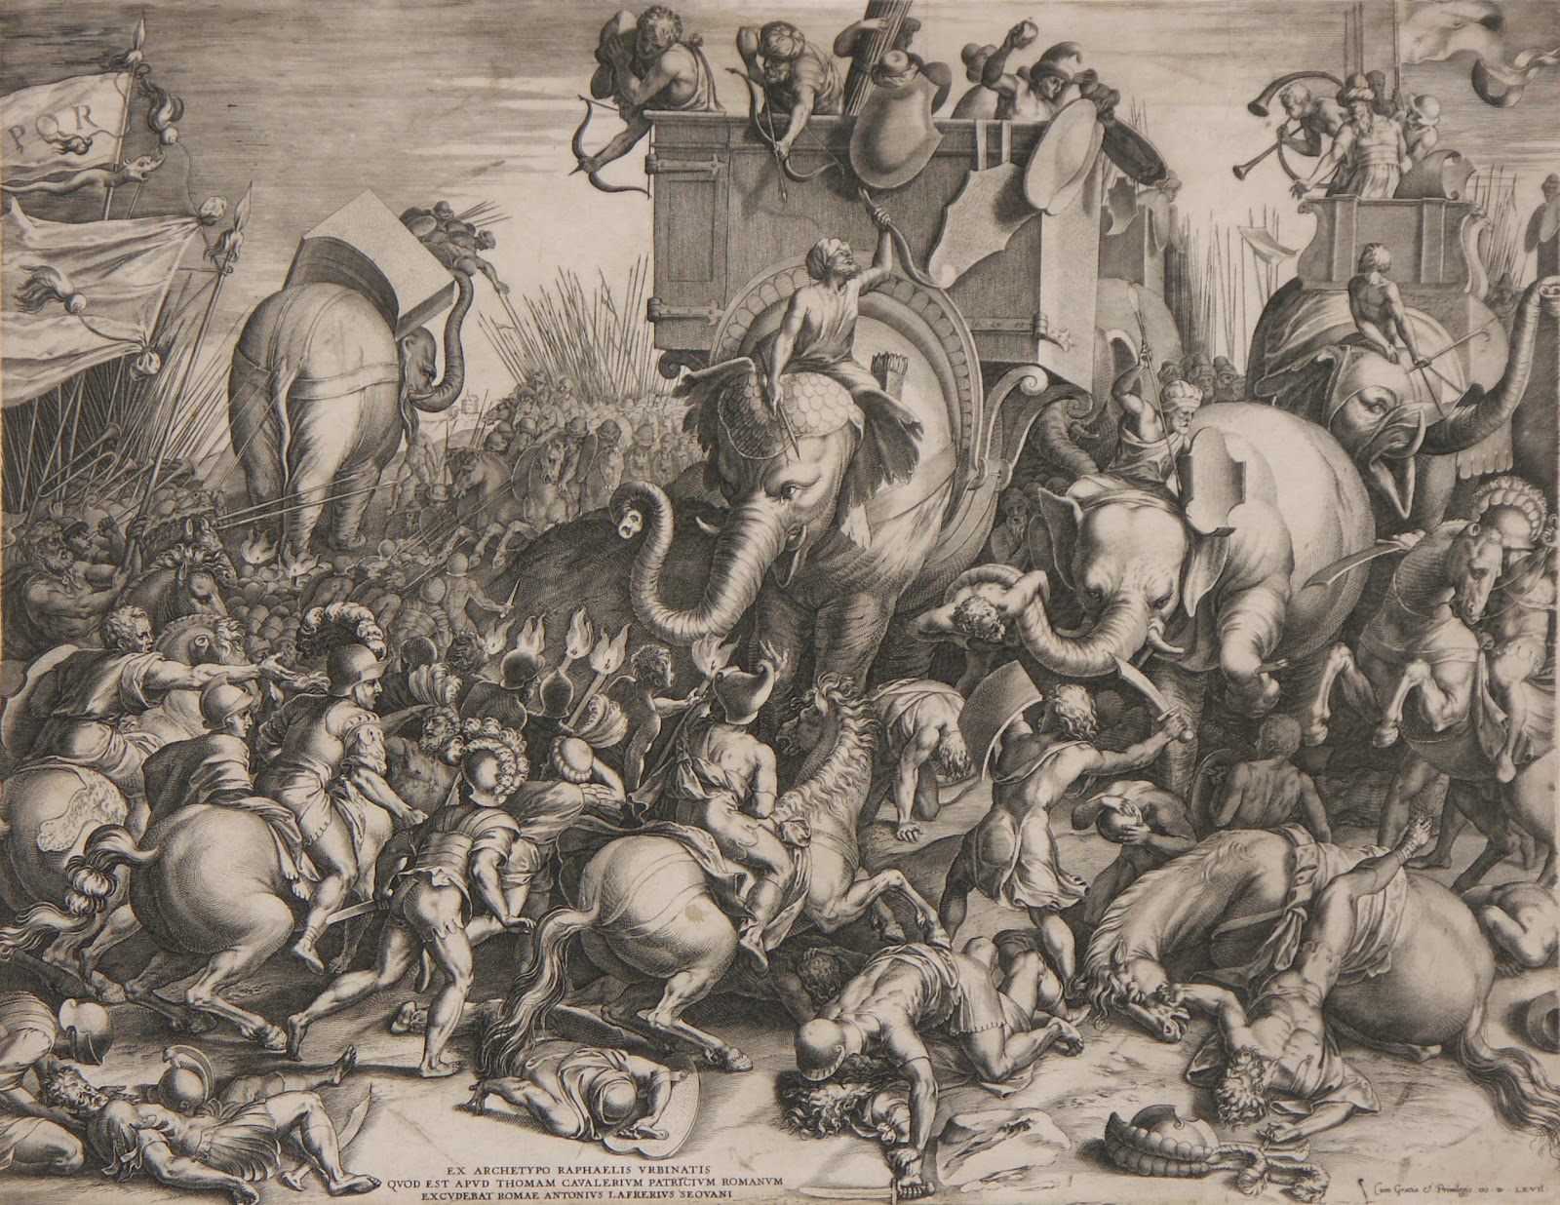
The Battle of Zama (202 bce)

Slide 21
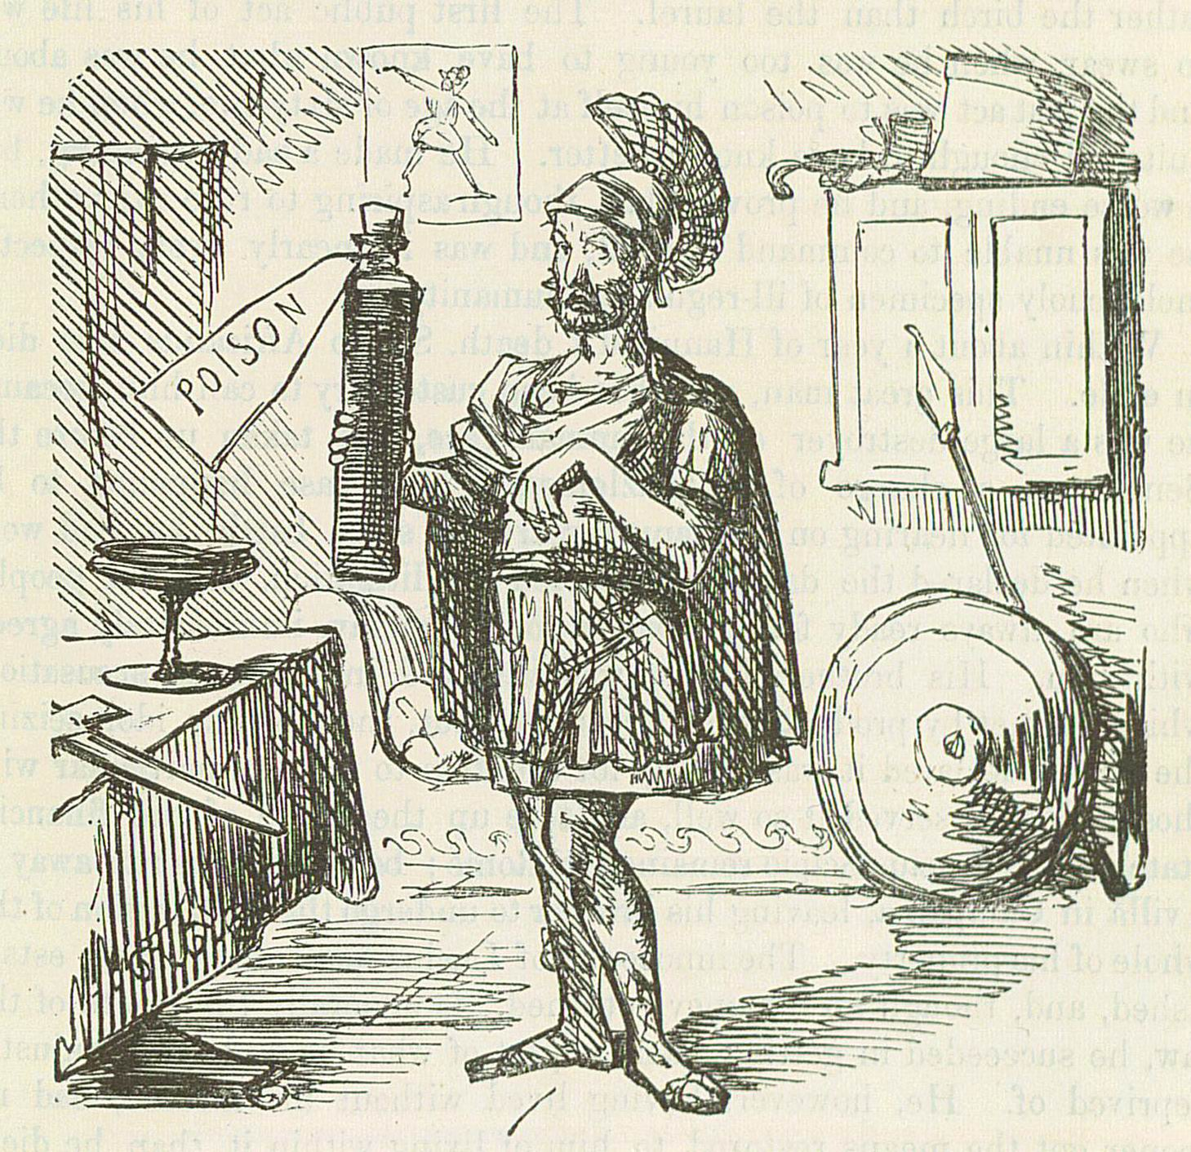
The Death of Hannibal
Became suffete of Carthage in 196 BCE
Exiled in 195
Went to the court of Antiochus III in Syria, who he served unsuccessfully as a general
Fled to Prusias I of Bithynia
Committed suicide in 183 rather than be handed over to the Romans

Slide 22
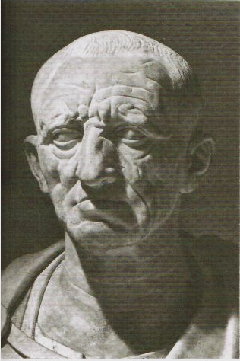
Karthago Delenda Est!
Marcus Porcius Cato (the Elder)
c. 234-149 BCE
Consul in 195, censor in 184
Ended every speech in the Senate with the words “Carthage must be destroyed.”

Slide 23
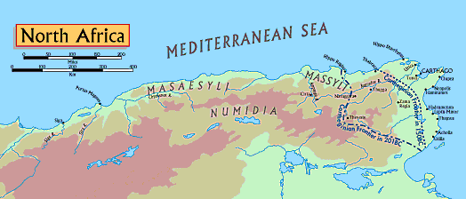
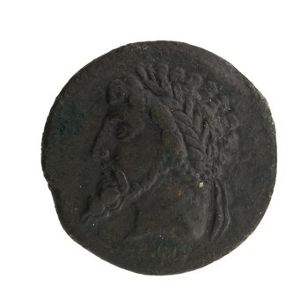
Third Punic War (149-146 bce)
Masinissa, king of Numidia from 201 to 148 BCE
Carthage finally defeated by Lucius Cornelius Scipio Aemilianus (adopted grandson of Scipio Africanus)

Slide 24
The Punic Wars
First Punic War (264-241)
Conquest of Sicily
Second Punic War (218-201 BCE)
Invasion of Italy by Hannibal
Conquest of Spain
Third Punic War (149-146 BCE)
Destruction of Carthage

Slide 25
Before…

Slide 26
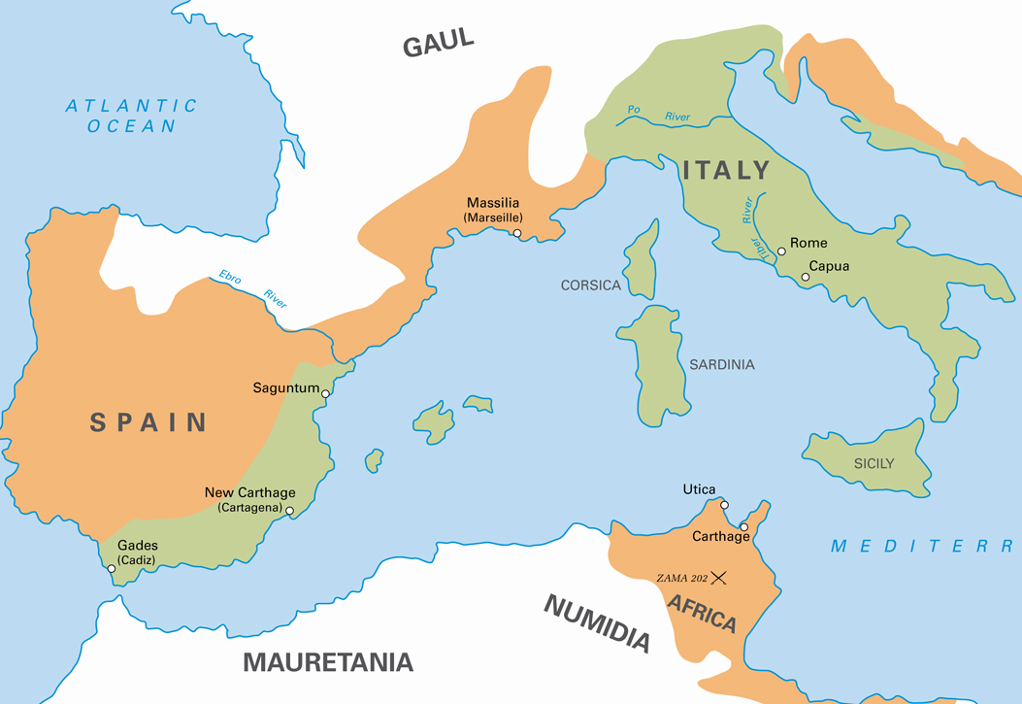
…and After

Slide 27
Key Terms
Polybius
Phoenicians
Carthage
Agathocles
Mamertines
Hamilcar Barca
Ebro
Saguntum
Hannibal
Cannae
Fabius Cunctator
Scipio Africanus
Zama
Cato the Elder Masinissa

